Slide 1


NFL Predictions Model
By Brandon Mather

Slide 2
Goals/Outcomes
Teams: How to win head-to-head matchups
Coaches: What contributes to winning
Companies/Outsiders: Possible better outcomes for gambling, bets, etc.

Slide 3
Description of Data
Initial data
10-years worth of every NFL teams annual statistics
Final Data
Last 5-years of a specific teams’ game by game statistics
Involves both defensive stats and offensive stats
Statistics Used
Points scored against, points scored, run yards against, interceptions thrown, interceptions by the defense, passing touchdowns, run yard, passing yard, run touchdowns against, passing touchdowns against, run touchdowns

Slide 4
Model Plan
Logistic Regression
Random Forest
Best options for finding probability to predict outcomes for head-to-head matchups

Slide 5
Evaluating Models
Combination of accuracy, precision, recall, F1 score
Feature Importance: Find which statistics matter most to a win or loss

Slide 6
First Model Attempt
First model attempt used 10 years of yearly NFL statistics
Began using logistic regression model, error outcomes
Example of error: Accuracy was 0 and none of the other evaluation metrics could be found

Slide 7
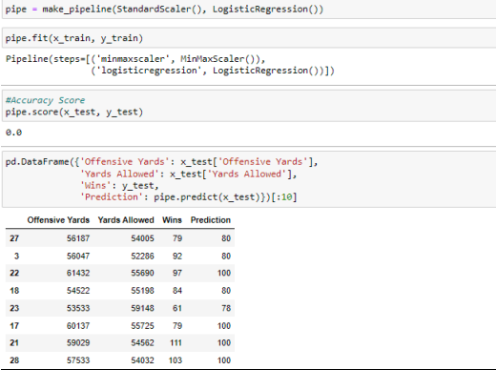
First Model Attempt – What Happened?
The beginning model predicted the outcome of how many wins a team could win in the next 10 years instead of head-to-head match ups
Failed to determine game-by-game statistics, instead determined yearly

Slide 8
Second Model Attempt – New Data
Changed data type from every NFL team, to one specific team to take game-by-game statistics for the last 5 years.
Chose the Green Bay Packers as a test team

Slide 9
Data Preparation
Combined all data together AND separated by Offense and Defense
Dropped all statistics that weren’t USEFUL for the model
Renamed Columns to be BETTER UNDERSTOOD instead of acronyms

Slide 10

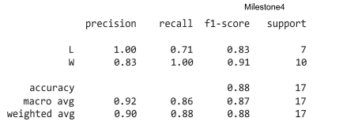
Logistic Regression Model
Created pipeline with a standard scaler then logistic regression
Was able to achieve an 88.2% accuracy score
Precision for predicting a loss was 1.00, recall .71 and F1 score was .83
Precision for predicting a win was .83, recall 1.00, F1 score was .91

Slide 11
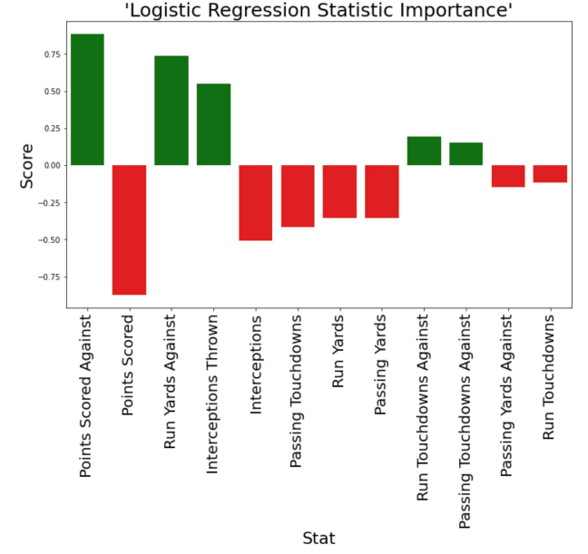
Feature Importance for Logistic Regression Model

Slide 12
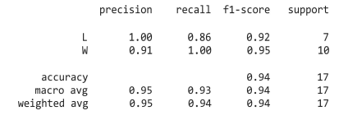
Random Forest
Created Random Forest model with 94.1% accuracy
Precision for predicting a loss was 1.00, recall .86 and F1 score was .92
Precision for predicting a win was .91, recall 1.00, F1 score was .95

Slide 13
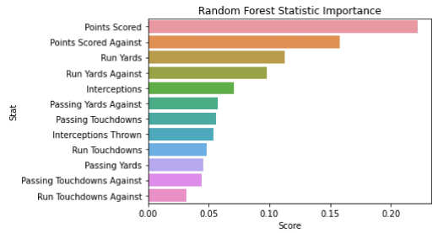
Feature Importance For Random Forest

Slide 14
Results/Conclusion
- First Model was unsuccessful
- New data was able to achieve goals of predicting individual game outcomes
- Between Logistic Regression and Random Forest Model, Random Forest scored better in most evaluation methods.
- Losses are better predicted then wins in both models
- Each team would need individual model
- Can be compared to get odds of winning a game
- Feature Importance shows what needs to be focused on for teams in order to win.

Slide 15
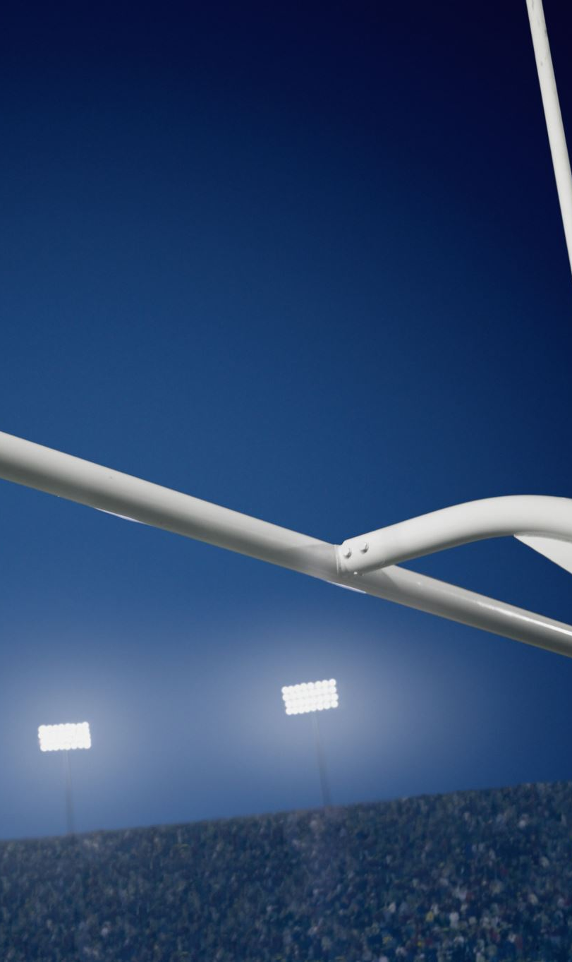
References
NFL Standings & Team stats. Pro Football Reference. (2023). https://www.pro-footballreference.com/

